Slide 1
Data Science Case Study: Recommendation Engine for Taxi Next Destination

Slide 2
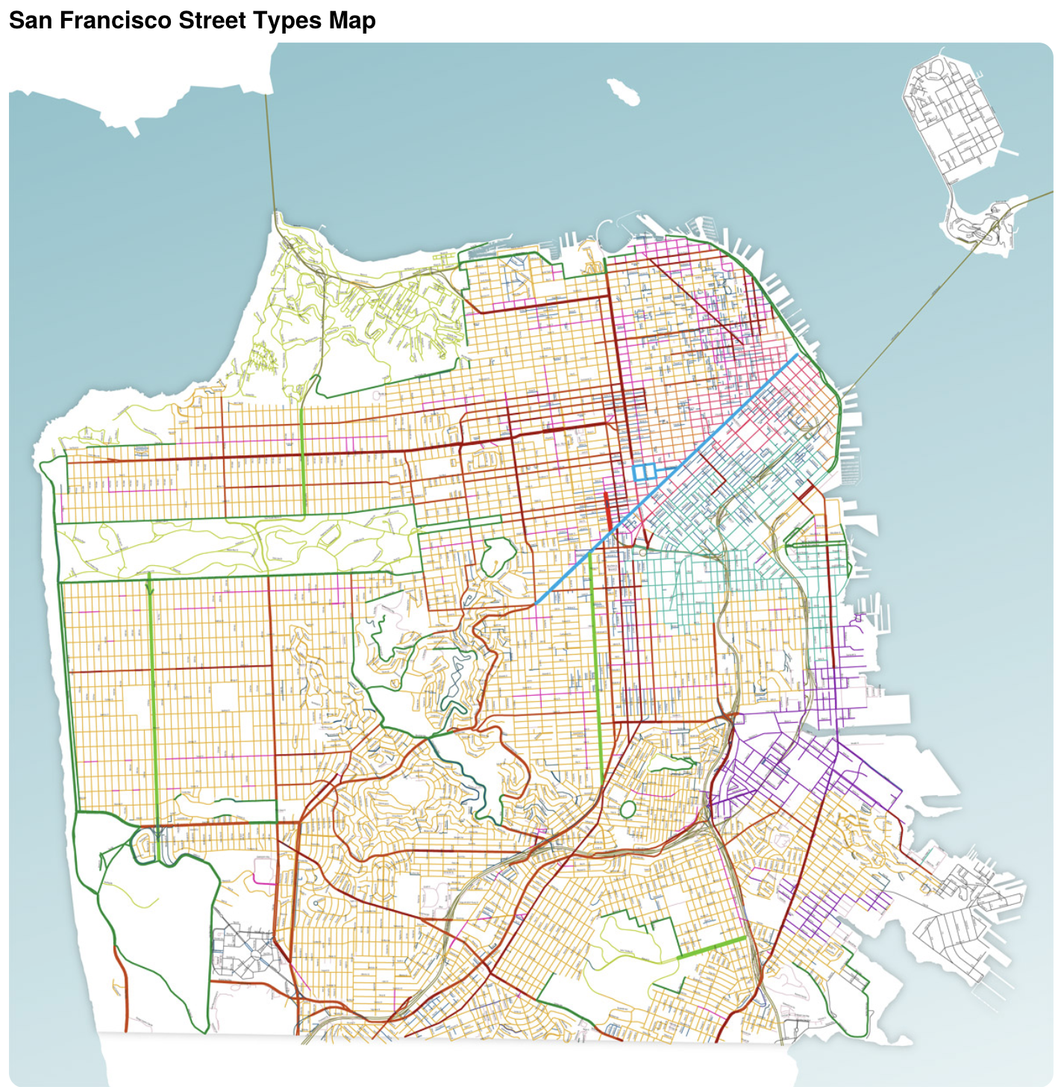
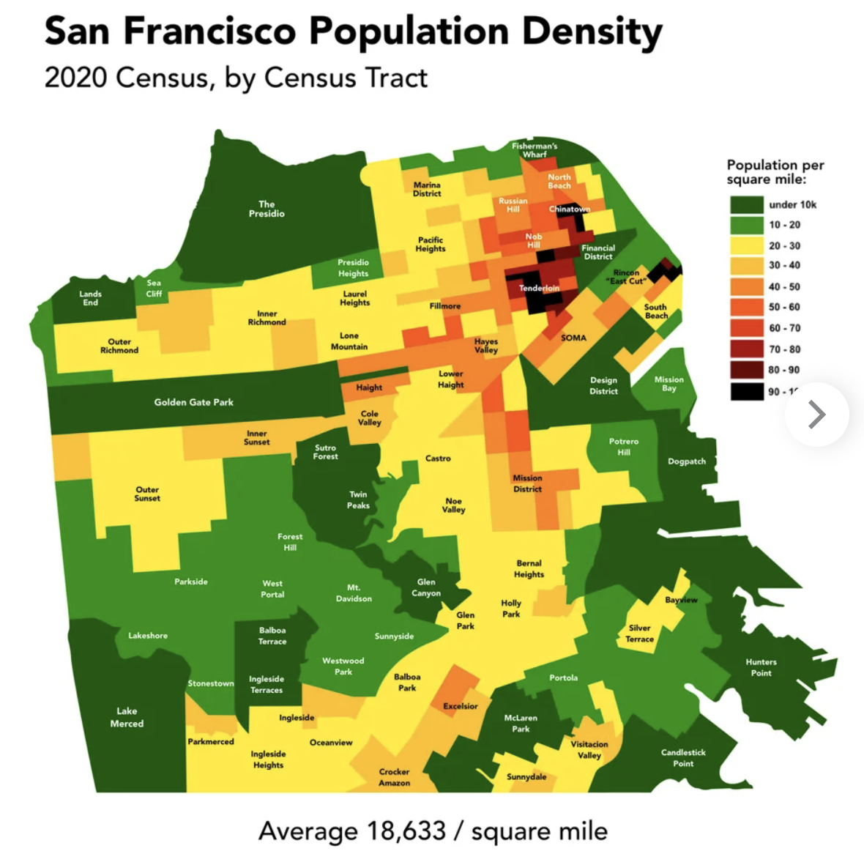
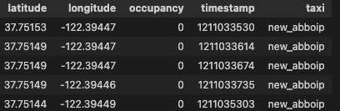
Background
With data on mobility traces of taxies (~500) in 30 days @ San Francisco
Q1: Calculate potential reduction of CO2 emissions in a year, when engine-powered vehicles will be replaced by electric vehicles at rate 15% per month
Q2: Build a predictor for taxi drivers, predicting the next place where a passenger will hail a cab
Data: https://github.com/PDXostc/rvi_big_data/blob/master/cabspottingdata.tar.gz

Slide 3
Q1: Potential Reduction of CO2 Emissions
Since the engine-powered vehicles will be replaced by electric vehicles at rate 15% per month, the month Co2 emission is a geometric sequence:
1, 0.85, 0.85^2, 0.85^3 …
Here “1” stands for the normalized amount of CO2 in the first month since taxi replacement starts (assumed to be the same as when all taxies are engine based, another hypothesis: each engine taxi exhausts the same amount of CO2 every month)
Therefore, in 12 months, the reduction rate of CO2 emission compared to the case before taxi replacement is
1-(1-0.85^12)/[(1-0.85)*12]=0.52
The total miles without passengers of all taxies in one month is 1263482 miles. Therefore, the total reduction potential of CO2 in one year is
1263482 mile*12*404 g/mile * 0.52= 3,206,430,468 g

Slide 4



Q2: Next Destination Recommendation for Occupation
Two step solution to construct a recommendation engine:
Build classification model on occupation at a given next place
Simulate on possible next destinations, and recommend the proming ones to drivers
Application scenario: when a taxi is roaming without a passenger

Slide 5
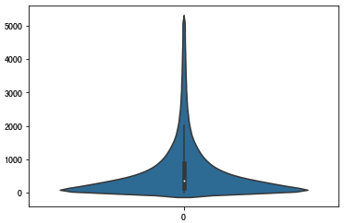
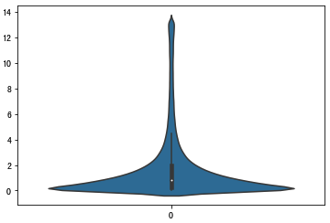
Drop-off -> Pick-up Session Data Construction
Session | Taxi | Timestamp | Position | Occupation
 | a |  |  | 1
1 | a | 1_t1 |  | 0
1 | a | 1_t2 |  | 0
1 | a | 1_t3 |  | 0
1 | a | 1_t4 |  | 1
 | a |  |  | 1
2 | a | 2_t1 |  | 0
2 | a | 2_t2 |  | 0
2 | a | 2_t3 |  | 1
 | a |  |  | 1
 | b |  |  | 1
 | b |  |  | 1
3 | b | 3_t1 |  | 0
3 | b | 3_t2 |  | 0
3 | b | 3_t3 |  | 1
 | b |  |  | 1
Distribution of session length in seconds
Distribution of session length in miles
Drop off
Pick up
Drop off
Each drop-off->pick-up full session will be further broken into sub sessions terminated by the steps in the sequential data E.g., for 1_t1 -> 1_t2 -> 1_t3 -> 1_t4 session, there will be data 1_t1 : target_variable
1_t1 -> 1_t2 : target_variable
1_t1 -> 1_t2 -> 1_t3: target_variable 1_t1 -> 1_t2 -> 1_t3 -> 1_t4: target_variable
The mastar table will be generated based on the above sub session data
(highly imbalanced: 8.4%)
Pick up
Drop off
Pick up

Slide 6
Feature Engineering and Target Variable Contruction
Feature Engineering
Taxi attributes: > Accumulated time since last drop-off > Accumulated moving duraiton since last drop-off > Direct distance from origin place of last drop-off > Speed > Current position > Current timestamp > Next position > Next timestamp
Traffic status: > Number of taxies in the city in past given time (e.g., past 1 minute) > Taxi occupation rate in the city in past given time > Number of taxies in the area surrounding the taxi in past given time > Taxi occupation rate in the area surrouding the taxi in past given time
Plus rolling features of the above (the above features at earlier/previous steps)
Target Variable Construction
Target: Occupation state at next position

Slide 7
Master Table Structure and Classification Model
We will build classification model based on the following master table structure
Other Features | Next Position | Next Timestamp | Occupation at Next Position
This is to answer such question: Given current known information (Taxi/journey attributes and the very recent traffic status), suppose the taxi is going to reach some destination as next step within a given time, what is the probility to get a passenger? * Next timestamp can be a fixed target, e.g., typicially 1 minute, the average duration in the recorded data.
* Requirement on model: > Good performance (high prediction ability) > Features to be simulated should be reatively important (target variable can respond effectively/sensitively to these features) The second requirement is not asked for when the purpose is just for prediction/forcasting (as we usually do)

Slide 8
Typical Recommendation System
With prediction ability by machine learning model, recommendation engine can be buit based on simulation
Simulation
Unchangeable features
Controllable features
Next Position 1 | Next Timestamp 1
Occupation at Next Position 1
0.1
Other Features
Next Position 2 | Next Timestamp 2
Predict
Occupation at Next Position 2
0.4
Combine
…
…
Next Position n | Next Timestamp n
Occupation at Next Position n
0.9
Recommendation

Slide 9
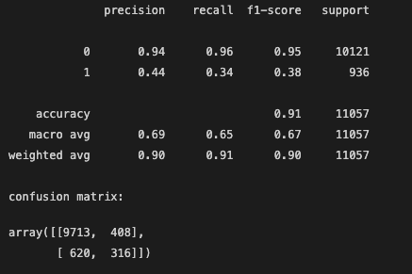
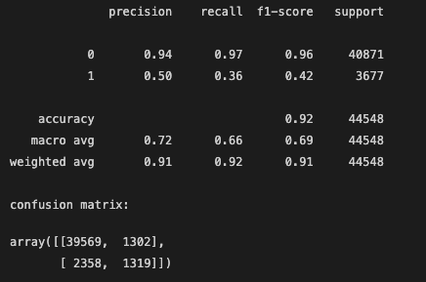
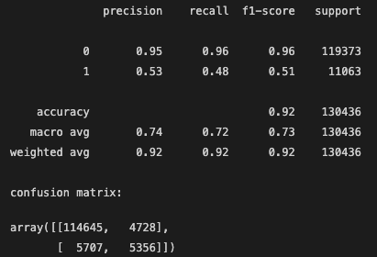
Model Performance – Evolution Along with Data Size Increase
Select Light GBM model out of [Light GBM, XGBoost, Random Forest] after comparison
1.1% sampling (Feature engineering: 36 min)
4.3% sampling (Feature engineering: 151 min)
13% sampling (Feature engineering: 450 min)
* Computation time is limited by the feature engineering on traffic status (calculation for each Taxi at each time step is done)
* Not using complete data set but just sampled data, due to computaiton resource and time limitation. * There is still room to further improve model performance, considering that at most I just used 13% of all data.

Slide 10
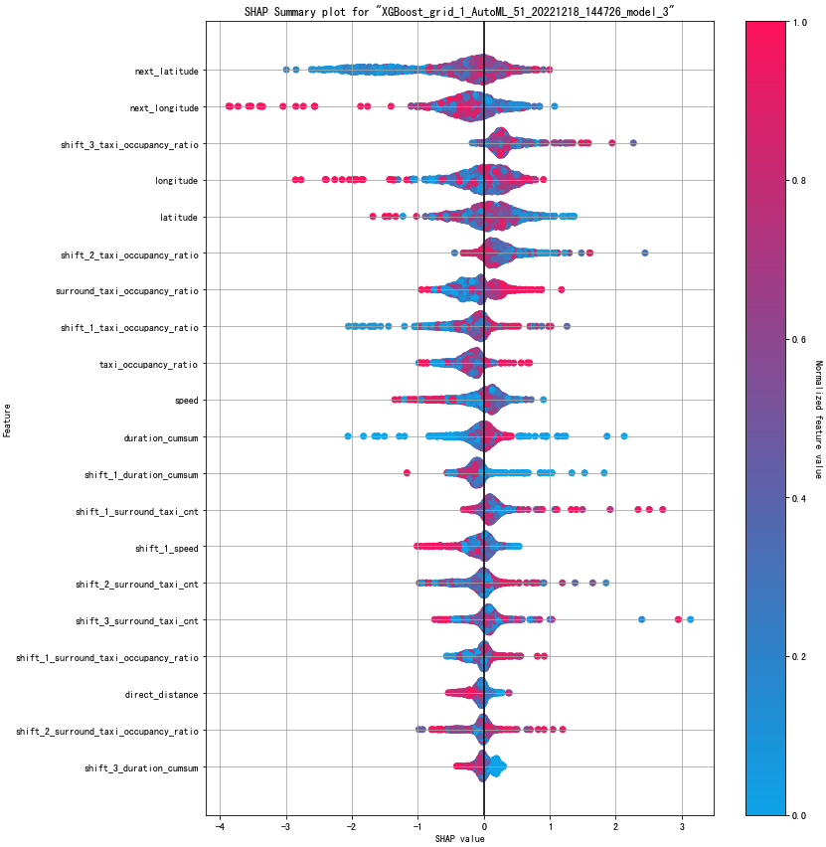
Feature Importance and Insight
Following three factors can bring higher probility to get a passenger for a taxi roaming without a passenger:
More northeast (closer to downtown)
Higher taxi occupancy ratio (higher demand on taxi usage)
Lower speed (easier to notice a passenger or the road is not high-speed trunk road)

Slide 11

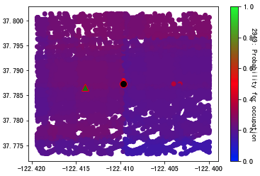
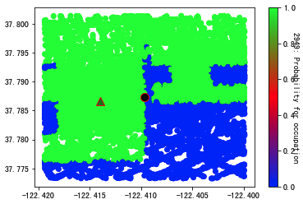
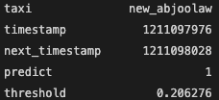

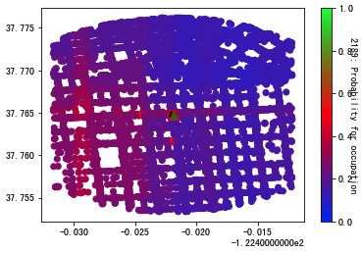
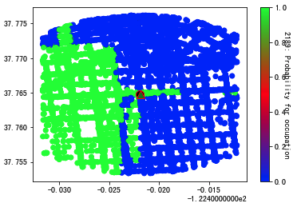
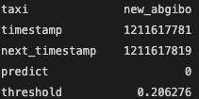
Recommendation Application & Verification
Correct Prediction
Current
Next (Pick up in actual)
Latitude
Wrong Prediction (nearly correct)
Possible movement range in a given duration (e.g., 1 minute) – simulation space
Limited by:
Speed
Road map
Longitude

Slide 12
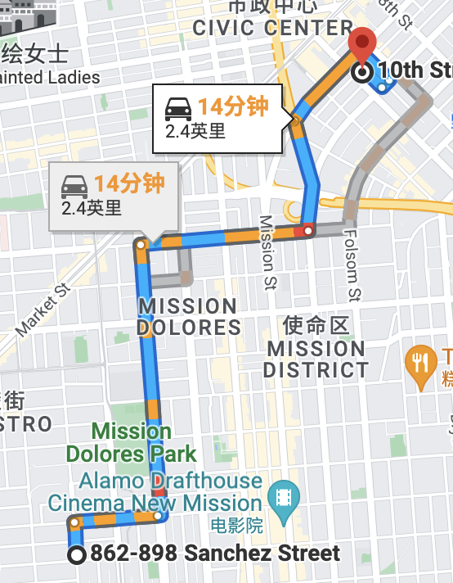
How Street Map Can be Outlined

Slide 13
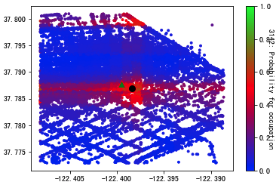
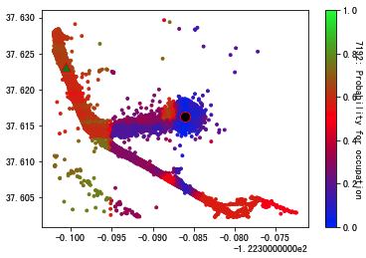
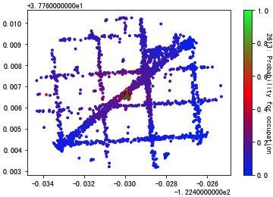
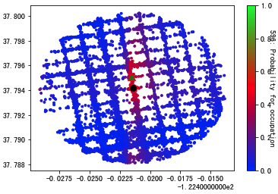
More Verified Recommendation Examples
Latitude
Longitude

Slide 14
Improvement Points
1. Regarding feature engineering complexity and heavy time consumption Drop some less important traffic status related features ,and modify the calculation method for the main traffic status related features
2. May try other features, such as occupation centers (hot spots) and distance of a taxi to these centers
Occupation hot sopt

Slide 15

Thank You!
Q & A

